Slide 1


Year 2 at DeWitt Middle School
Aisha Lynn Thomas
Solution Tree Author and Associate
“JEDI Educators” on Facebook
https://schoolsystemsandculture.com/
aisha.thomas@gmail.com
Insert QR code
Notes:
Purpose: Have participants understand the relationship among the adults in the school is foundational to success in the PLC framework.

Slide 2



Three words to describe you are as an educator…can’t use job title.
Notes:
Who you be?
So here I am, in front of educators, with a grammatically incorrect slide? But think about this, when you meet someone new, there are typically two questions that get asked “How are you? and What do you do?” Those are good questions but with some pitfalls. First, how you are may be conditional to your life situation that day and not a truly good measure of you. And answering what you do is a title not necessarily reflective of what you do. Like, my best friend, who is a principal doesn’t do principaling. She communicates, analyzes choices, inspires others and makes decisions everyday, all day. But if we really want to connect with someone, I’d argue that the question is “Who you be?” Instead of “I am tired or I am a teacher,” we say “I be inspired” “I be loved” “I be joyful”.

Slide 3

Synergy
Happy
Grateful
Notes:
For me, I am a mother. That’s my job title. It’s an important one but it doesn’t completely articulate who Aisha is. But, who I be? Well, I be synergy. I be happy. I be grateful. If you know these things about me, you know my core. So, who you be? Turn to an elbow partner and without using job title, share a few words that come to mind about who you be.

Slide 4

Today’s Learning
Review Professional Learning Community Foundations
Agree on our Mission, Vision, Values, and Goals
Create Systems to Live our Culture in Action

Slide 5


Today’s Resource
Learning by Doing,
Third Edition by
Richard DuFour, Rebecca DuFour,
Robert Eaker, Thomas Many, Mike Mattos

Slide 6

“An essential prerequisite to ensuring that all students learn at the highest level is believing that all students can learn and want to succeed.
Yes, the work is hard. No, you won’t always get it right.
But once you stop believing, you stop trying -- and that ain’t right.”
Bill Ferriter
Career Classroom Teacher
Notes:
Give Bill credit for slide deck template

Slide 7
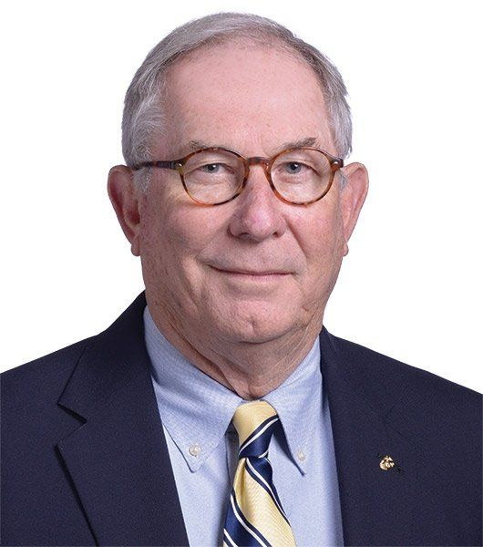
“You can make all the complicated plans you want, but higher levels of learning starts when we PULL UP A CHAIR next to a student and teach them to do something they don’t know how to do.”
Bob Eaker
Personal Communication, Little Rock PLC at Work Institute, June 25, 2022
Notes:
Tell the story how Bob pulled up a chair with my school at an Institute.

Slide 8
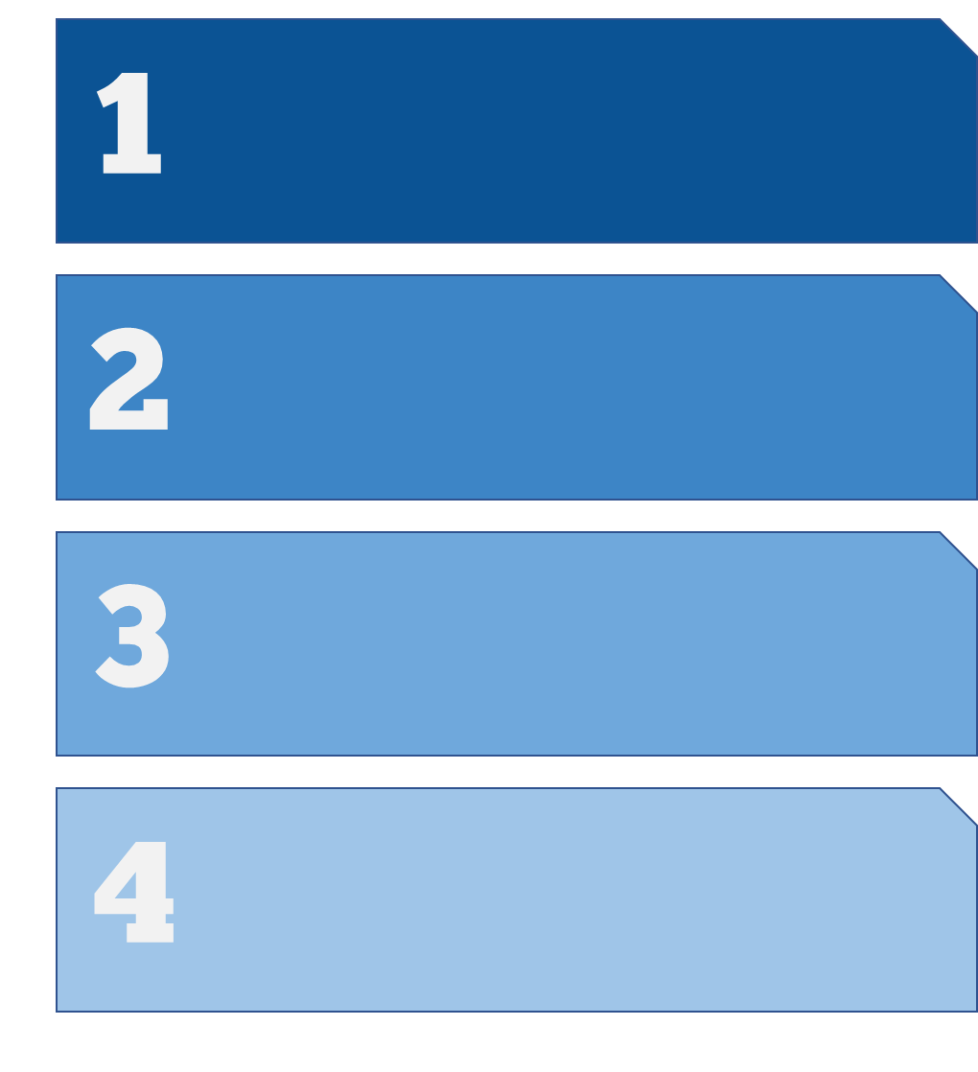
Focus on Learning
Three Big Ideas
Creating a Collaborative Culture
Focus on Results

Slide 9
What do we expect students to learn?
Four Critical Questions
of a
PLC at Work
How do we know that students are learning?
How will we respond when students are not learning?
How will we respond when students have already learned?

Slide 10
“Our goal is not to become a professional learning community. Our goal is to help students learn more.
Working together as a PLC is JUST HOW WE GET THERE.”
Bob Eaker
Solution Tree PLC Associate Retreat,
November 11, 2022

Slide 11

Four Pillars: Foundations of a PLC
01
02
03
04
Mission
Vision
Values
Goals
WHY?
WHAT?
HOW?
WHEN?

Slide 12
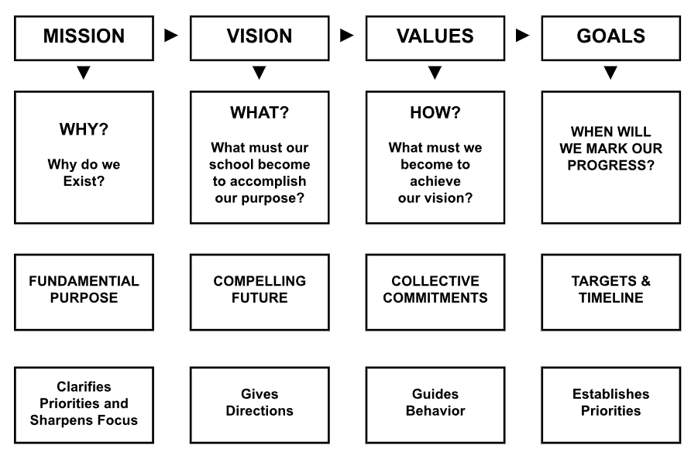

Slide 13
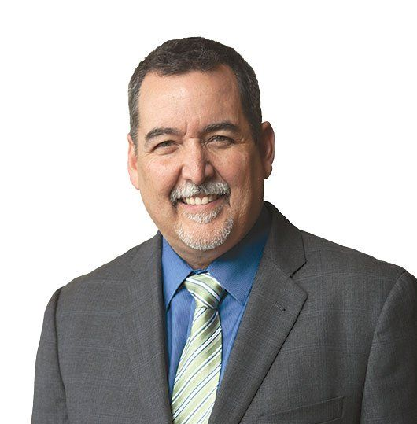
“If there is one thing for certain…it is this: Educators are going to work hard.
The question is not whether we will work hard, but will we WORK HARD AND SUCCEED or work hard and fail?”
Mike Mattos
Taking Action: A Handbook for RTI at Work
Notes:
Mike likes to describe this as identifying “the list within the list.” Can you tell us more about that, Mike?

Slide 14
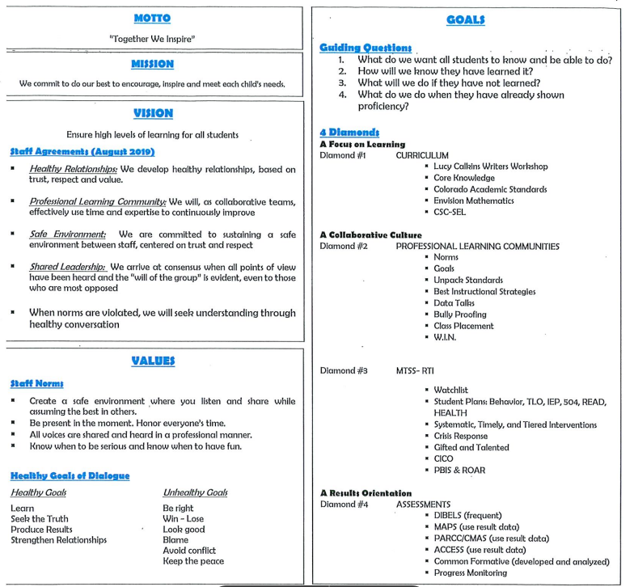
Are we closer to this?

Slide 15
Break

Slide 16
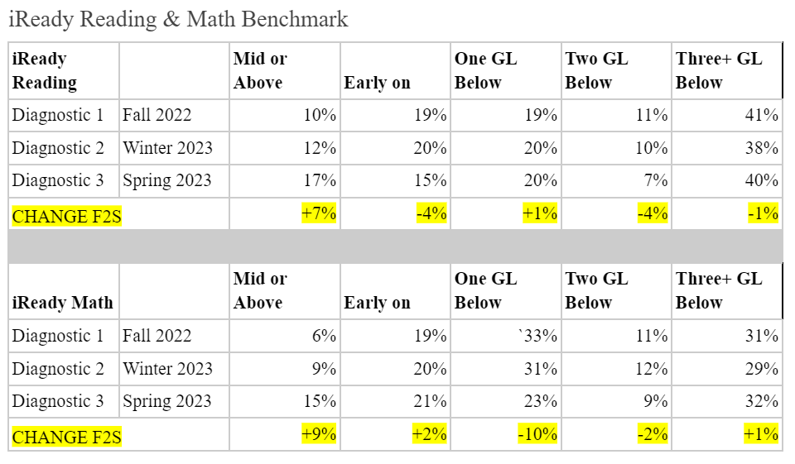

Slide 17
Goal Setting…
Current reality
Greatest strengths
Roadblocks

Slide 18
Help me to understand your current reality NOW.

Slide 19
What do you see as your school’s greatest strengths NOW?

Slide 20
What do you see as possible roadblocks to the success of this project NOW?

Slide 21
Break

Slide 22



LBD Continuums Work
Building a Collaborative Culture through High Performing Teams p.80-81
Communicating
Effectively
p.16-17
Laying the Foundation
p.47-49
Divide into three groups, underline what your is your school and you have evidence to prove it. Highlight what you want your school to be.

Slide 23
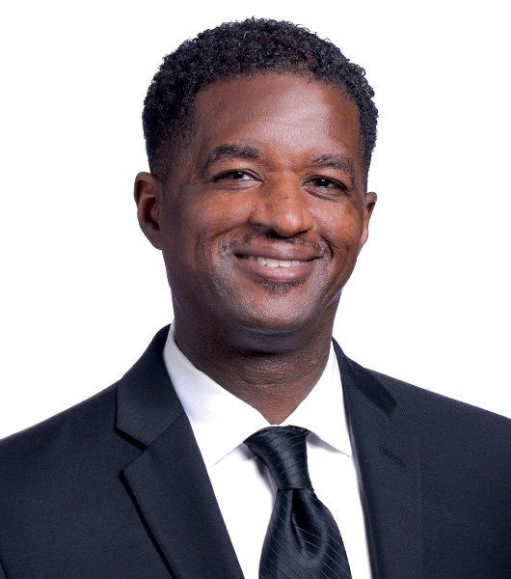
“Children are not mature enough to understand the ramifications of academic failure. We require individuals to be age 16 to drive, 18 to vote, and 21 to drink alcohol, yet we regularly give children “licenses to fail” at a much younger age when they do not exhibit immediate interest in academics.”
Anthony Muhammad
Transforming School Culture: How to Overcome Staff Division, 2018.

Slide 24

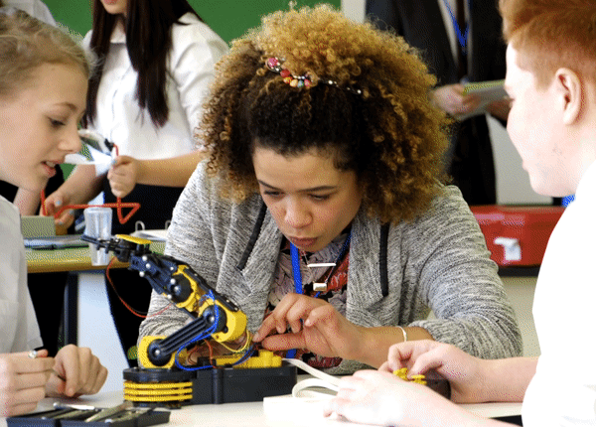
Let’s build our yearlong plan!
What does DeWitt MS need?
How can Guiding Coalition lead the work?
How can your Solution Tree Associate team support?

Slide 25
Break

Slide 26

Thank You!
To schedule professional development at your site, contact Solution Tree at 800.733.6786.
Aisha Lynn Thomas • aisha.thomas@gmail.com
‹#›

