Slide 1


Hamburg July 25 & 26,2023
Aisha Lynn Thomas
Solution Tree Author and Associate
schoolsystemsandculture.com
aisha.thomas@gmail.com
Notes:
Purpose: Have participants understand the relationship among the adults in the school is foundational to success in the PLC framework.

Slide 2
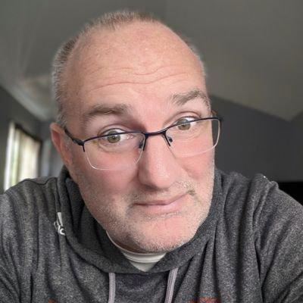
“An essential prerequisite to ensuring that all students learn at the highest level is believing that all students can learn and want to succeed.
Yes, the work is hard. No, you won’t always get it right.
But once you stop believing, you stop trying -- and that ain’t right.”
Bill Ferriter
Career Classroom Teacher
Notes:
Give Bill credit for slide deck template

Slide 3
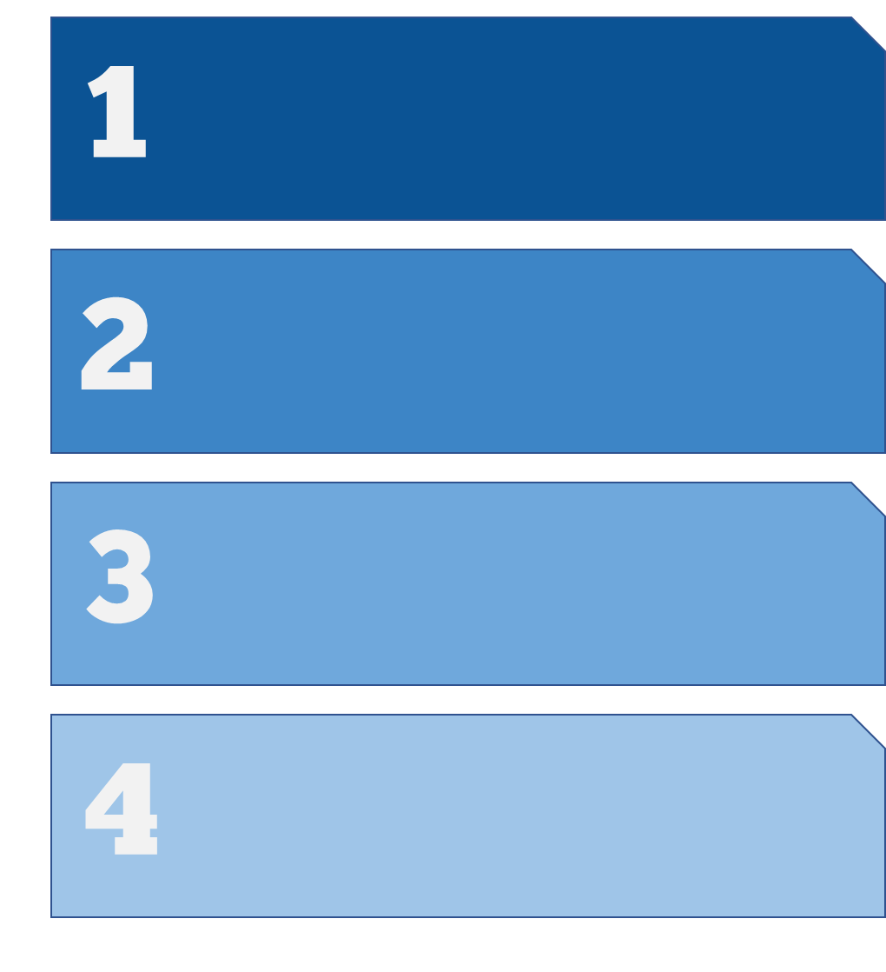
Focus on Learning
Three Big Ideas
Creating a Collaborative Culture
Focus on Results

Slide 4
What do we expect students to learn?
Four Critical Questions
of a
PLC at Work
How do we know that students are learning?
How will we respond when students are not learning?
How will we respond when students have already learned?

Slide 5
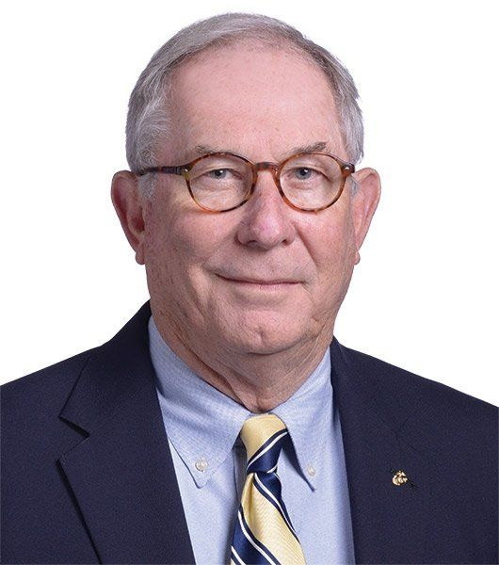
“Our goal is not to become a professional learning community. Our goal is to help students learn more.
Working together as a PLC is JUST HOW WE GET THERE.”
Bob Eaker
Solution Tree PLC Associate Retreat,
November 11, 2022

Slide 6
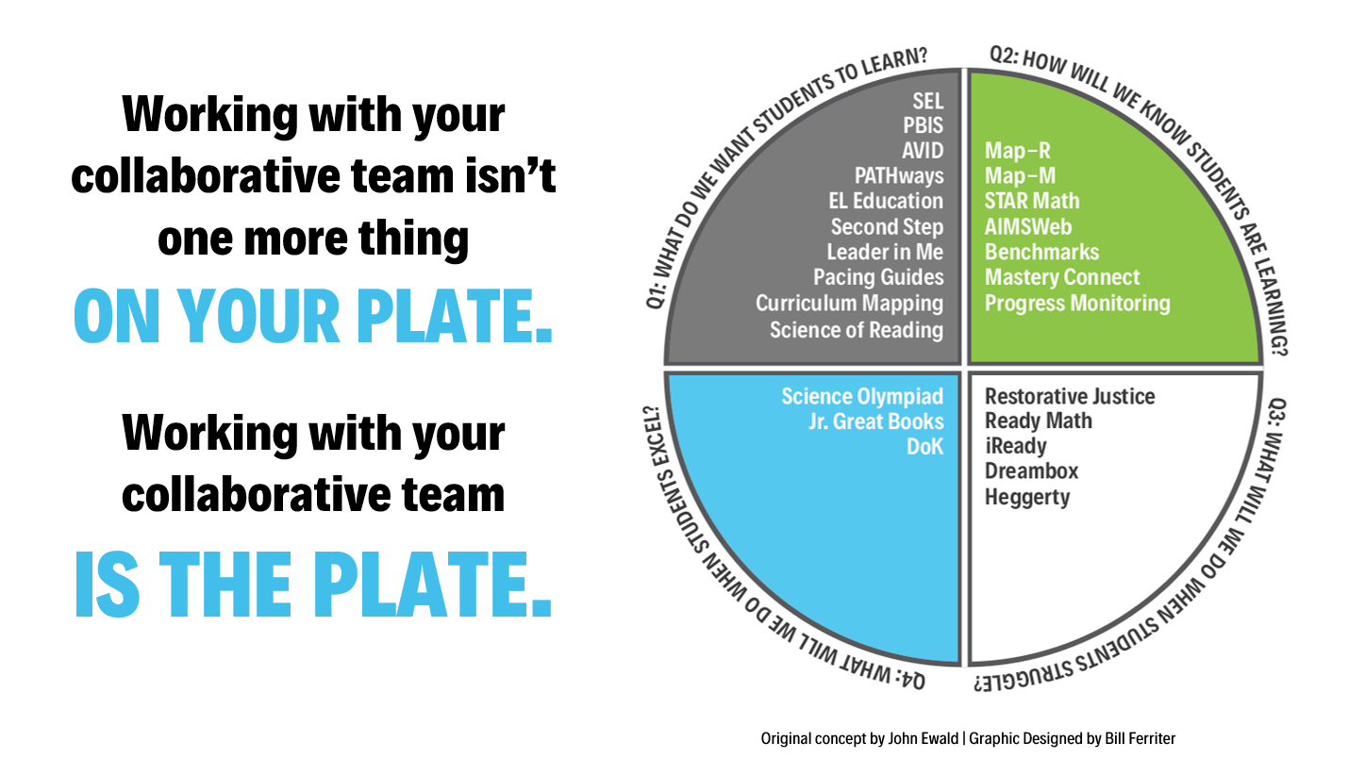

Slide 7
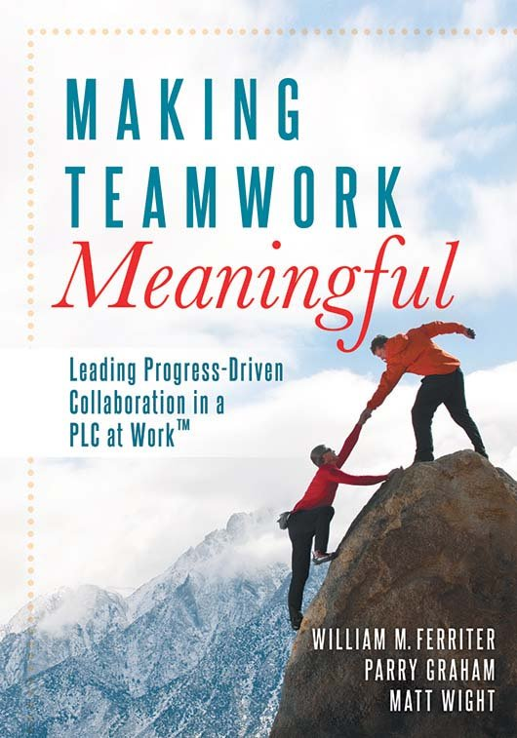
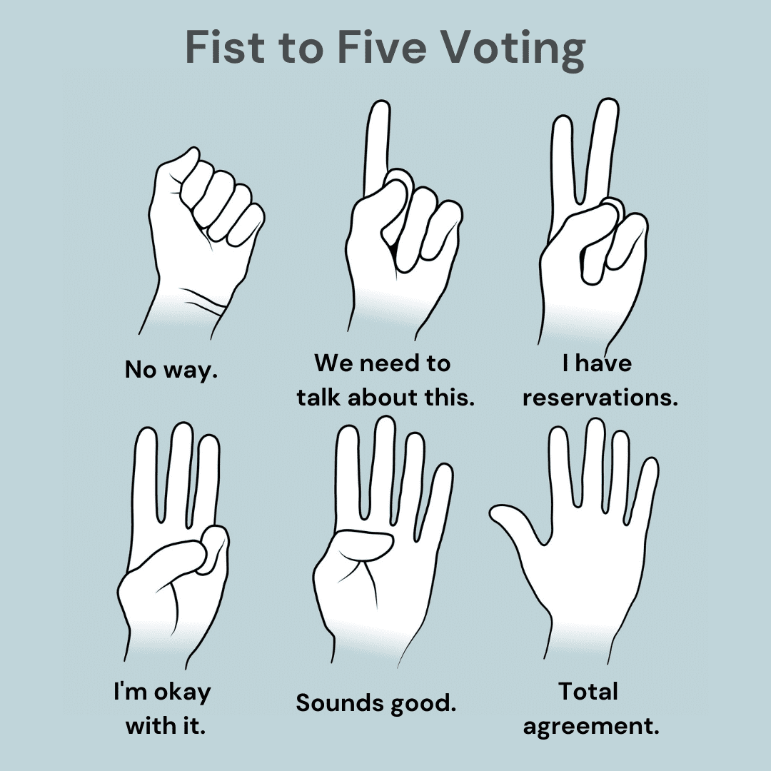
Meeting Protocols
Agendas
Minutes
Norms
Decision-Making
Purpose driven expectations
Consensus means that after all voices have been solicited and heard, the will of the group is evident even to those most opposed.

Slide 8
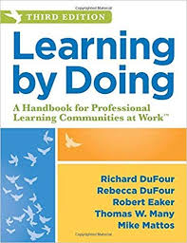
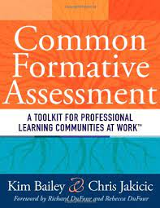
Today’s Resources
Learning by Doing, Third Edition
Richard DuFour, Rebecca DuFour, Robert Eaker, Thomas Many, Mike Mattos
Common Formative Assessment
Kim Bailey & Chris Jakicic

Slide 9
What do we want all students to learn?
Determine or review essential learning progressions.
Unpack standard(s)/bundle
“What does successful
student work look like?”
How will we know they have learned it?
Develop common formative assessment (CFA).
Set CFA proficiency.
Set protocols—when and how to assess.
Set SMART goal.
Teach.
Check for understanding .
Appropriately adjust—Differentiation.
Analyze data.
Discuss best practices and learning results.
Give common formative assessment.
Plan based on CFA results.
How will we respond when learning
has not occurred?
How will we respond when learning
has already occurred?
Reteach: Best practices, individualize, small group Deploy: Match need to student.
Extend and deepen learning.
Reassess learning.
Produce a product based on standard.

Slide 10
Another View of Process
Use R.E.A.L. protocol to identify essential standards.
Unwrap essential standards and write learning targets.
Align learning targets to DOK.
Agree on key vocabulary and prerequisite skills.
Choose instructional scaffolds and supports.
Choose assessment type and type/# of questions.
Write questions and answers (or pull from a resource.)
Using results, identify groups of learners (direct instr, practice, extend)
Instruct on interventions and extensions in class.
Meet with team and chart results from pre/post intervention.

Slide 11
