Slide 1


Year 2 at San Cayetano Elementary
Aisha Lynn Thomas
Solution Tree Author and Associate
“JEDI Educators” on Facebook
https://schoolsystemsandculture.com/
aisha.thomas@gmail.com
Insert QR code
Notes:
Purpose: Have participants understand the relationship among the adults in the school is foundational to success in the PLC framework.

Slide 2



Three words to describe you are as an educator…can’t use job title.
Notes:
Who you be?
So here I am, in front of educators, with a grammatically incorrect slide? But think about this, when you meet someone new, there are typically two questions that get asked “How are you? and What do you do?” Those are good questions but with some pitfalls. First, how you are may be conditional to your life situation that day and not a truly good measure of you. And answering what you do is a title not necessarily reflective of what you do. Like, my best friend, who is a principal doesn’t do principaling. She communicates, analyzes choices, inspires others and makes decisions everyday, all day. But if we really want to connect with someone, I’d argue that the question is “Who you be?” Instead of “I am tired or I am a teacher,” we say “I be inspired” “I be loved” “I be joyful”.

Slide 3
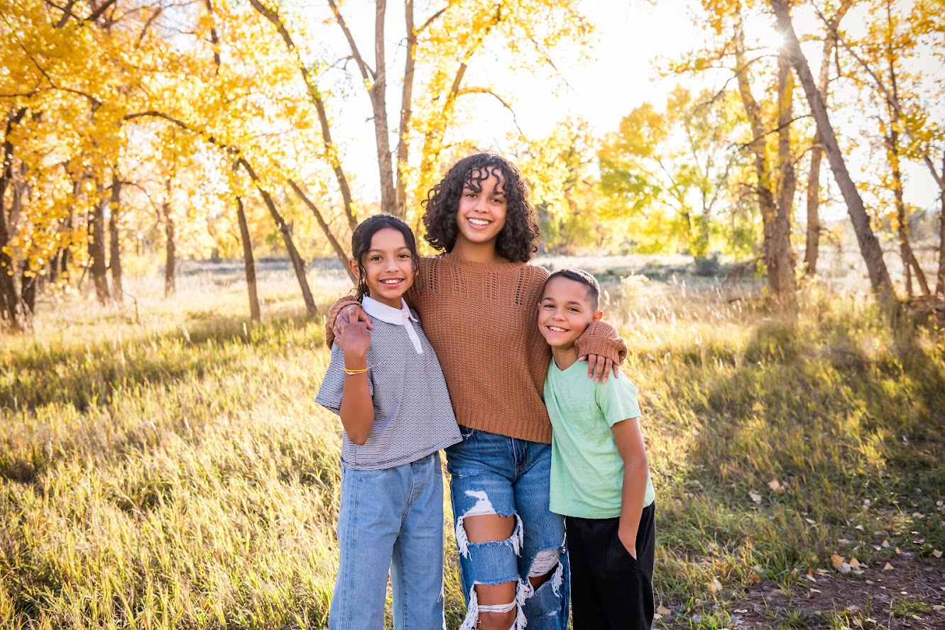
Synergy
Happy
Grateful
Notes:
For me, I am a mother. That’s my job title. It’s an important one but it doesn’t completely articulate who Aisha is. But, who I be? Well, I be synergy. I be happy. I be grateful. If you know these things about me, you know my core. So, who you be? Turn to an elbow partner and without using job title, share a few words that come to mind about who you be.

Slide 4

Today’s Learning
Review Professional Learning Community Foundations
Agree on our Mission, Vision, Values, and Goals
Create Systems to Live our Culture in Action

Slide 5

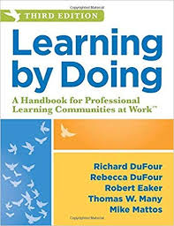
Today’s Resource
Learning by Doing,
Third Edition by
Richard DuFour, Rebecca DuFour,
Robert Eaker, Thomas Many, Mike Mattos

Slide 6
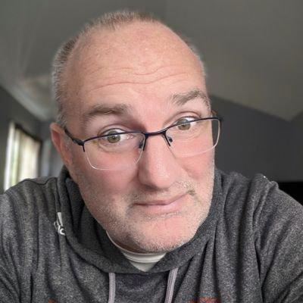
“An essential prerequisite to ensuring that all students learn at the highest level is believing that all students can learn and want to succeed.
Yes, the work is hard. No, you won’t always get it right.
But once you stop believing, you stop trying -- and that ain’t right.”
Bill Ferriter
Career Classroom Teacher
Notes:
Give Bill credit for slide deck template

Slide 7
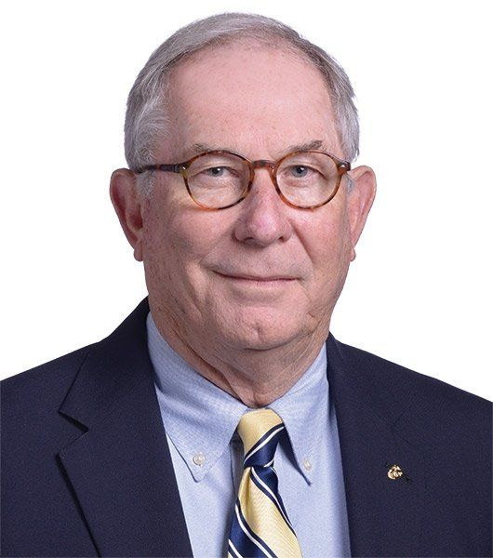
“You can make all the complicated plans you want, but higher levels of learning starts when we PULL UP A CHAIR next to a student and teach them to do something they don’t know how to do.”
Bob Eaker
Personal Communication, Little Rock PLC at Work Institute, June 25, 2022
Notes:
Tell the story how Bob pulled up a chair with my school at an Institute.

Slide 8
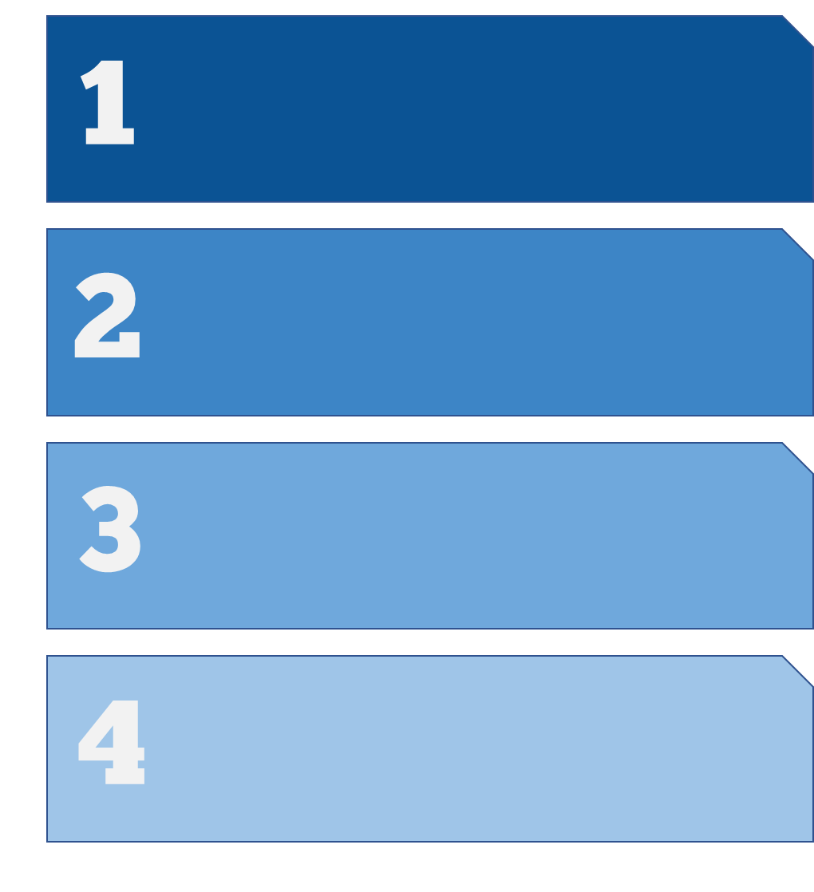
Focus on Learning
Three Big Ideas
Creating a Collaborative Culture
Focus on Results

Slide 9
What do we expect students to learn?
Four Critical Questions
of a
PLC at Work
How do we know that students are learning?
How will we respond when students are not learning?
How will we respond when students have already learned?

Slide 10
“Our goal is not to become a professional learning community. Our goal is to help students learn more.
Working together as a PLC is JUST HOW WE GET THERE.”
Bob Eaker
Solution Tree PLC Associate Retreat,
November 11, 2022

Slide 11

Four Pillars: Foundations of a PLC
01
02
03
04
Mission
Vision
Values
Goals
WHY?
WHAT?
HOW?
WHEN?

Slide 12
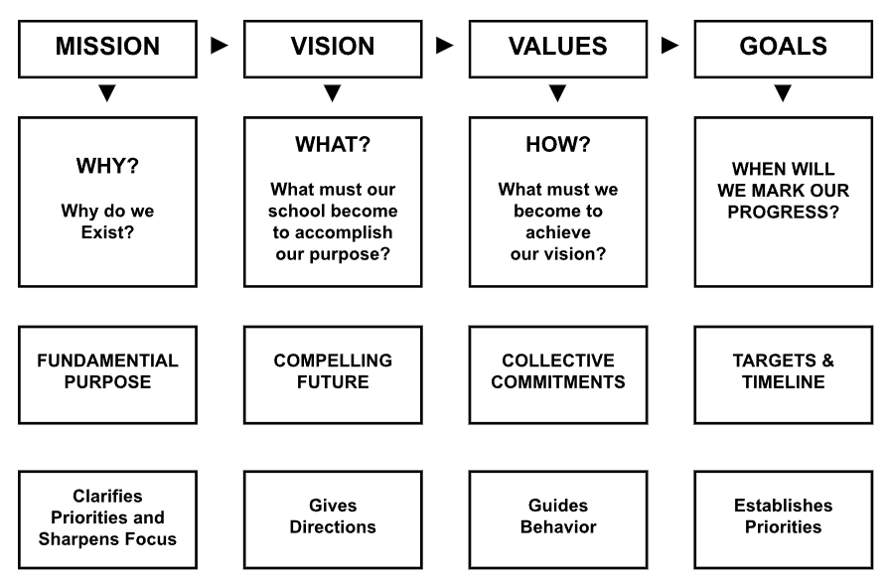

Slide 13
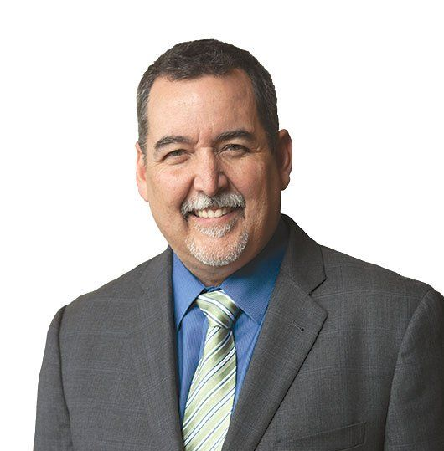
“If there is one thing for certain…it is this: Educators are going to work hard.
The question is not whether we will work hard, but will we WORK HARD AND SUCCEED or work hard and fail?”
Mike Mattos
Taking Action: A Handbook for RTI at Work
Notes:
Mike likes to describe this as identifying “the list within the list.” Can you tell us more about that, Mike?

Slide 14
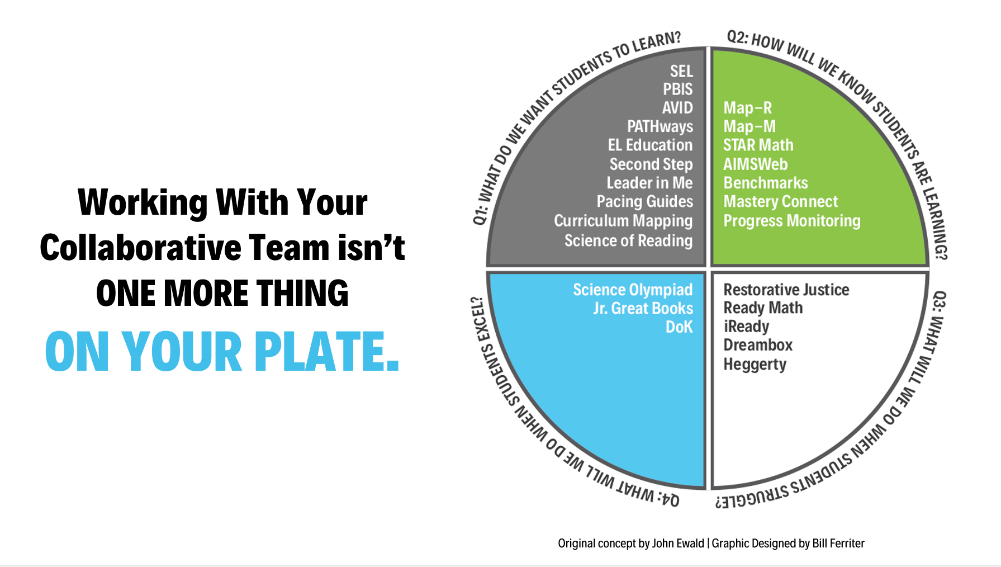

Slide 15
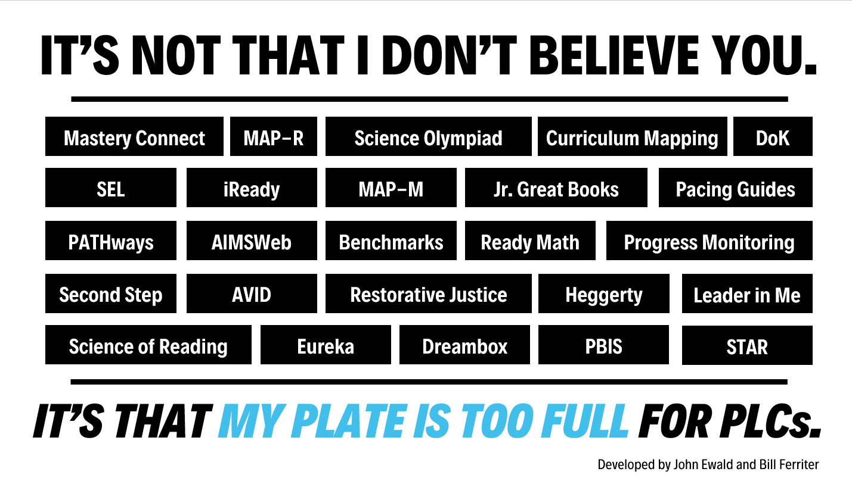

Slide 16
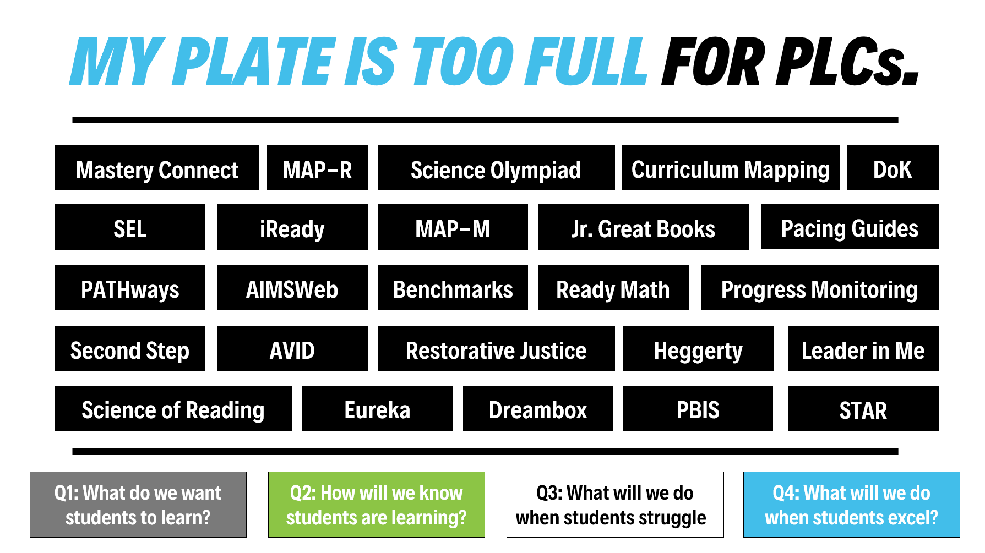

Slide 17
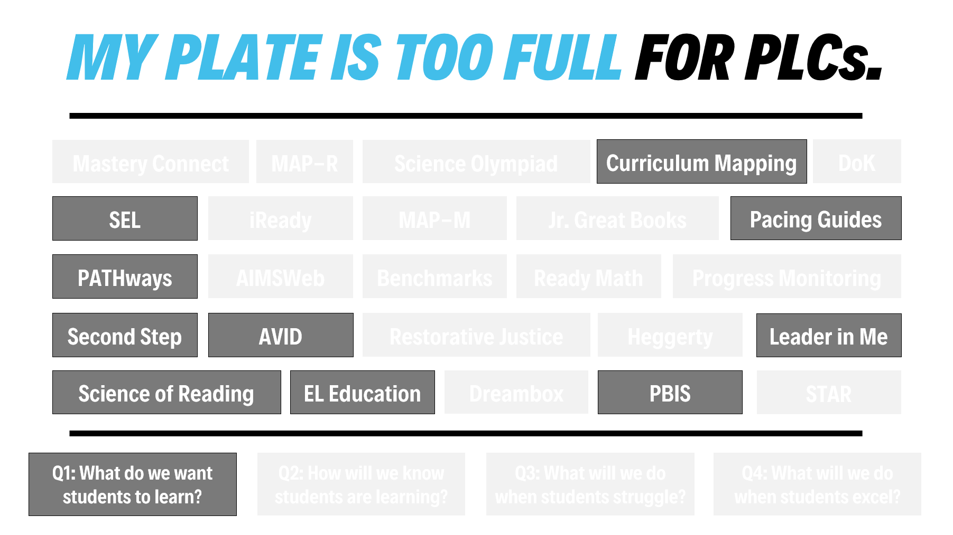

Slide 18
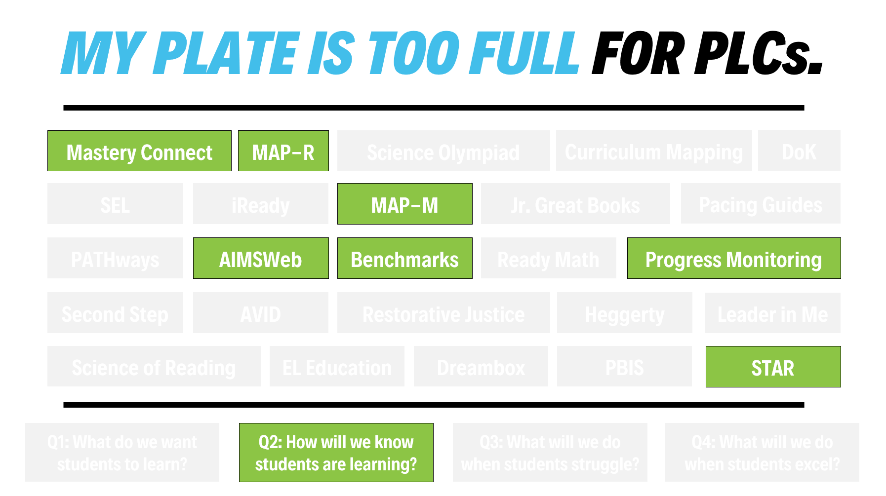

Slide 19
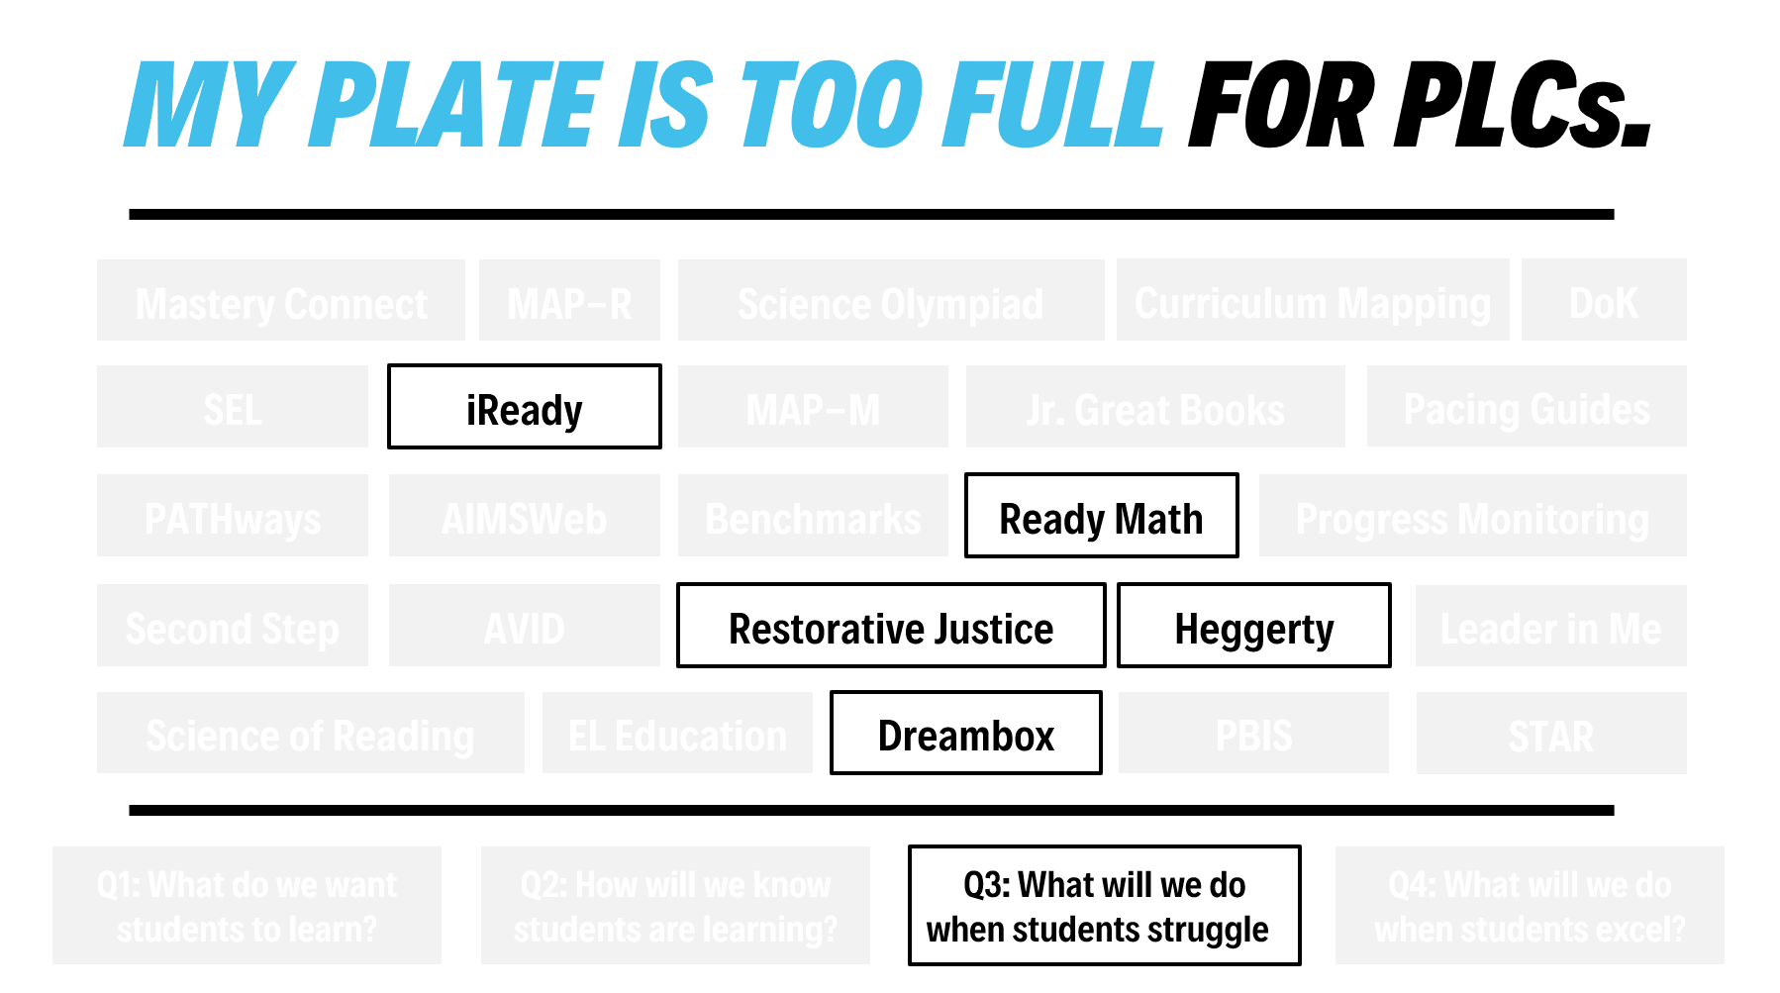

Slide 20
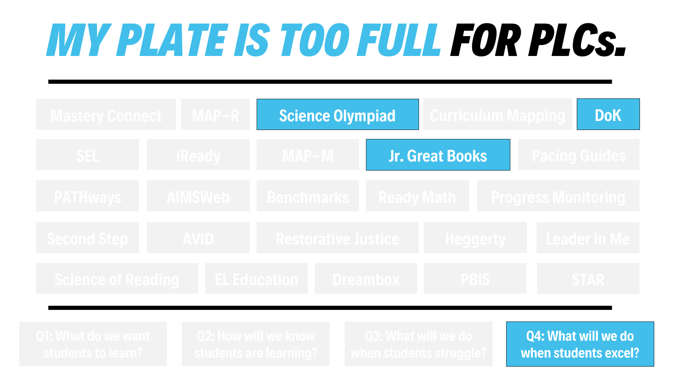

Slide 21
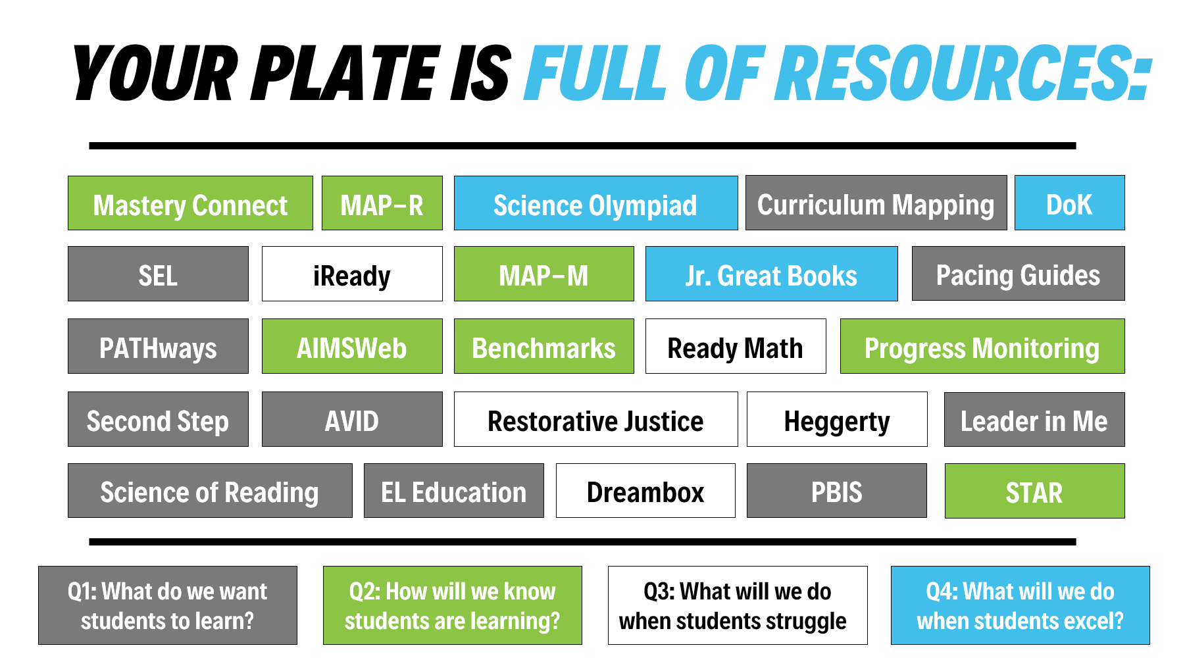

Slide 22
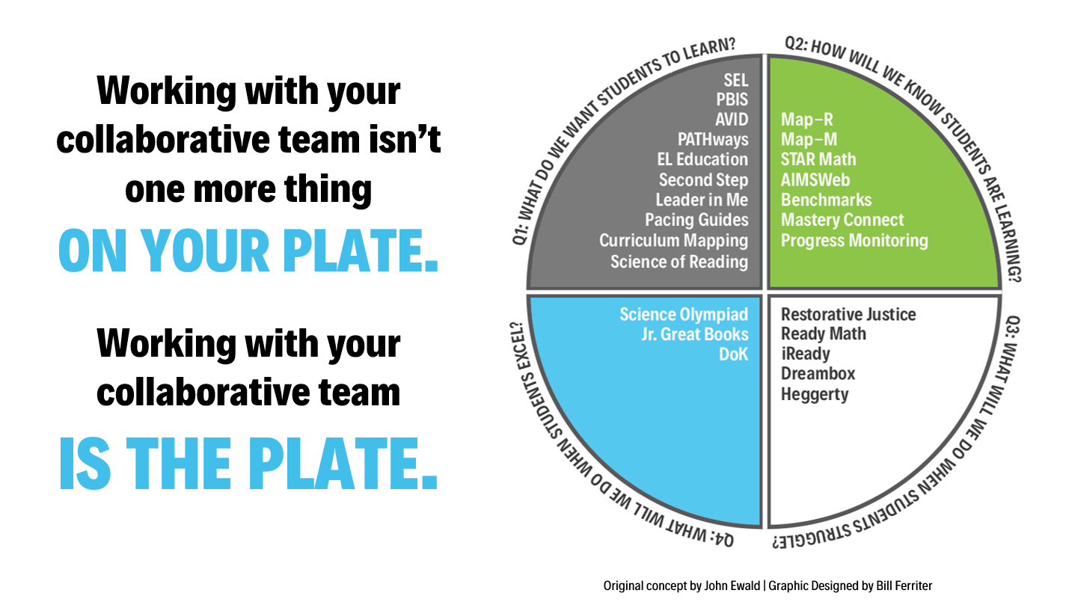

Slide 23
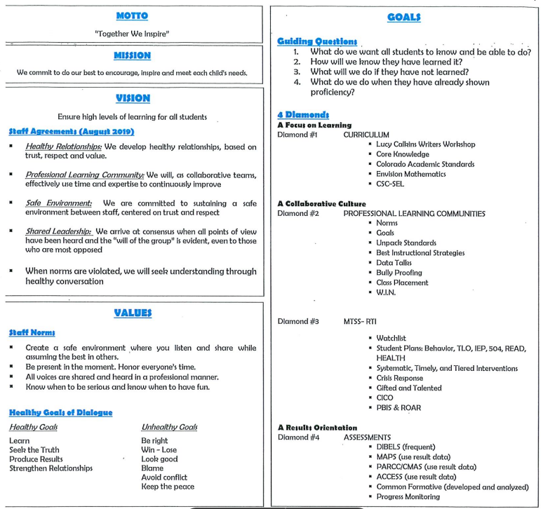

Slide 24
Brainstorm in groups of 3, ALL the things on your plate as a school!
Write one thing per sticky note.

Slide 25
Now place the sticky notes on the board in categories:
State/District Mandated
Site Mandated
Teacher Initiated
Place duplicate sticky notes on top of one another.

Slide 26
Now place the sticky notes from each category into one of the four critical questions.
Place duplicate sticky notes on top of one another.

Slide 27
Are we closer to this?

Slide 28
Break

Slide 29
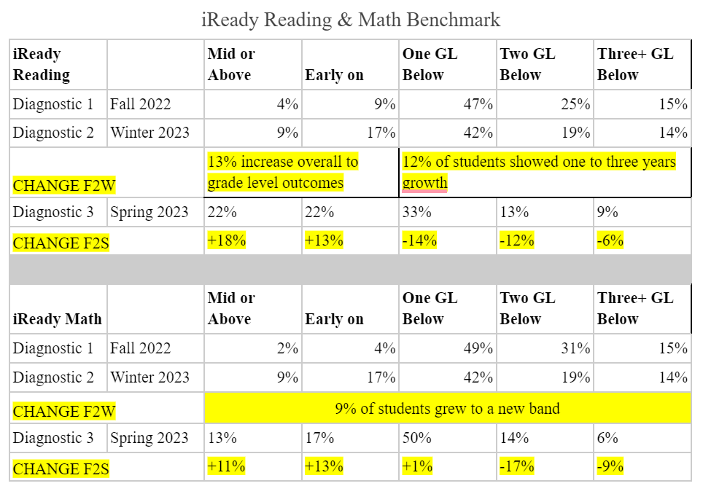

Slide 30
Goal Setting…
Current reality
Greatest strengths
Roadblocks
What you said last year was….

Slide 31
Help me to understand your current reality.
Teachers are working as hard as possible but the results aren’t seen at a high level.
Collaboration happens formally weekly.
462 students TK-5
All grade levels give district wide benchmark assessment, which take a week to give and is a loss of instructional time
New district leadership and new initiatives
A desire to gather more accurate data on student learning

Slide 32
Help me to understand your current reality NOW.
Everyone is working hard-committed to the work
Identified essential standards
Creating pacing guide for essential standards
Have yet to win over the whole community
Increased enrollment
Staff is an little overwhelmed with the PLC implementation
Staff want to integrate fun into their classroom
CFA and iReady data is positive!

Slide 33
What do you see as your school’s greatest strengths?
Positive culture and climate
Treat each other with respect
Teams collaborate
Teachers share resources with all
Students enjoy learning and want to be here, kind to one another
School is a safe place for kids

Slide 34
What do you see as your school’s greatest strengths NOW?
Improved on…
Positive culture and climate
Treat each other with respect
Teams collaborate
Teachers share resources with all
Students enjoy learning and want to be here, kind to one another
School is a safe place for kids

Slide 35
What do you see as possible roadblocks to the success of this project?
Lack of home support for some of the students with the highest needs
Resistance to change- might feel like “another” thing to do
Lack of planning time
Current master schedule
There has been a change of special education, encore, & intervention personnel

Slide 36
What do you see as possible roadblocks to the success of this project NOW?
Although staff in onboard philosophically, the implementation is still overwhelming
Lack of planning time
Off site demands that conflict with onsite goals, workload, and daily implementation
Insufficient class time to do all the things

Slide 37
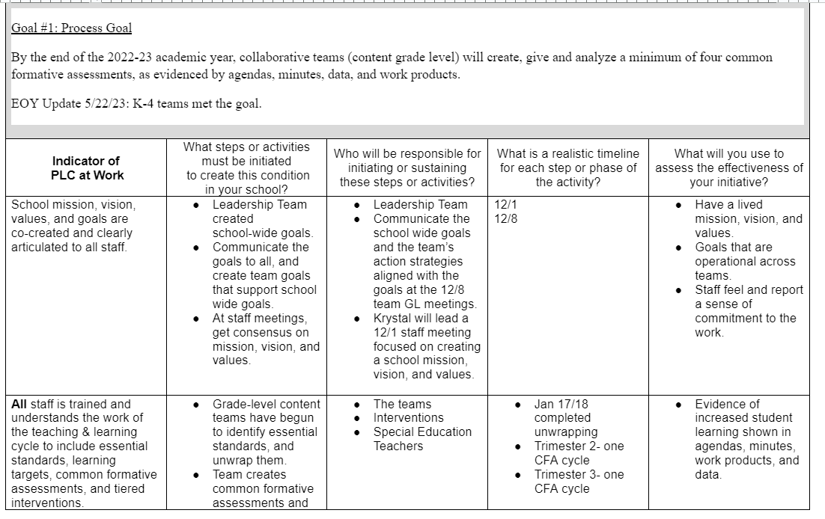

Slide 38
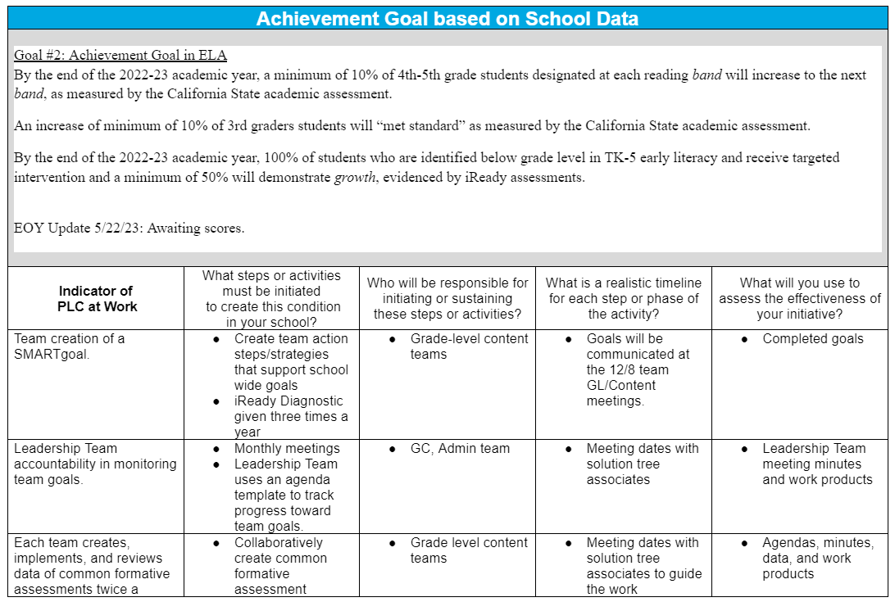

Slide 39
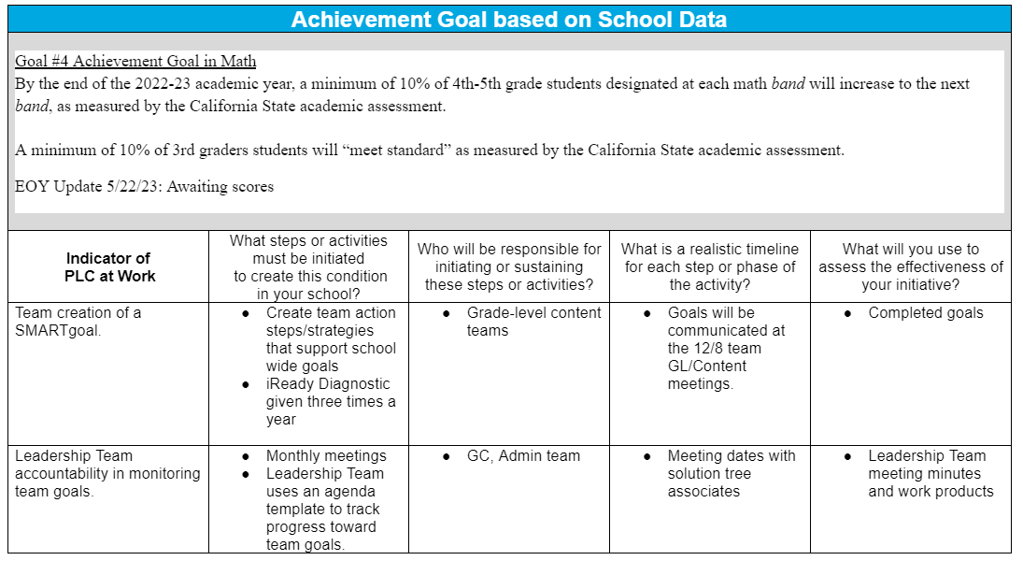

Slide 40
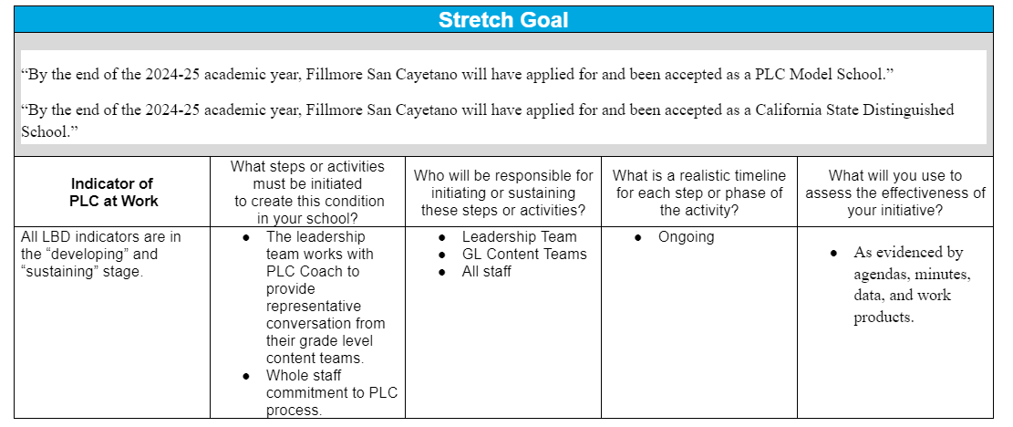

Slide 41
Break

Slide 42
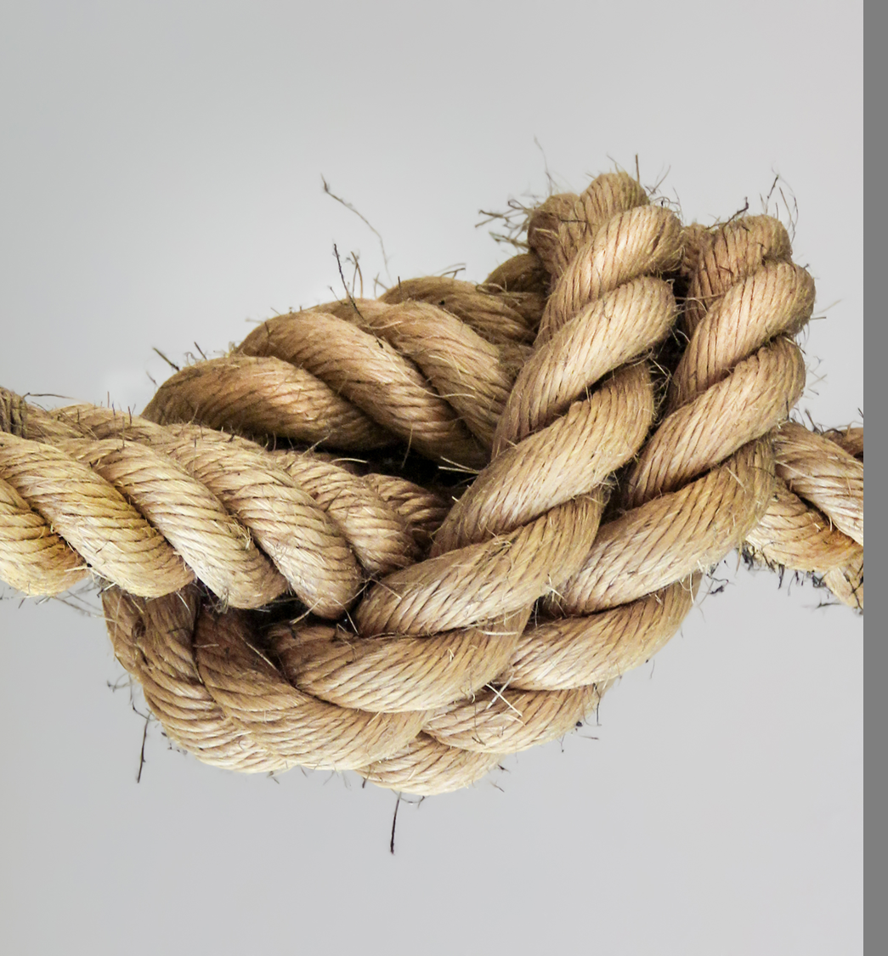
One area I see that we get ourselves into knots at SC ES is…

Slide 43
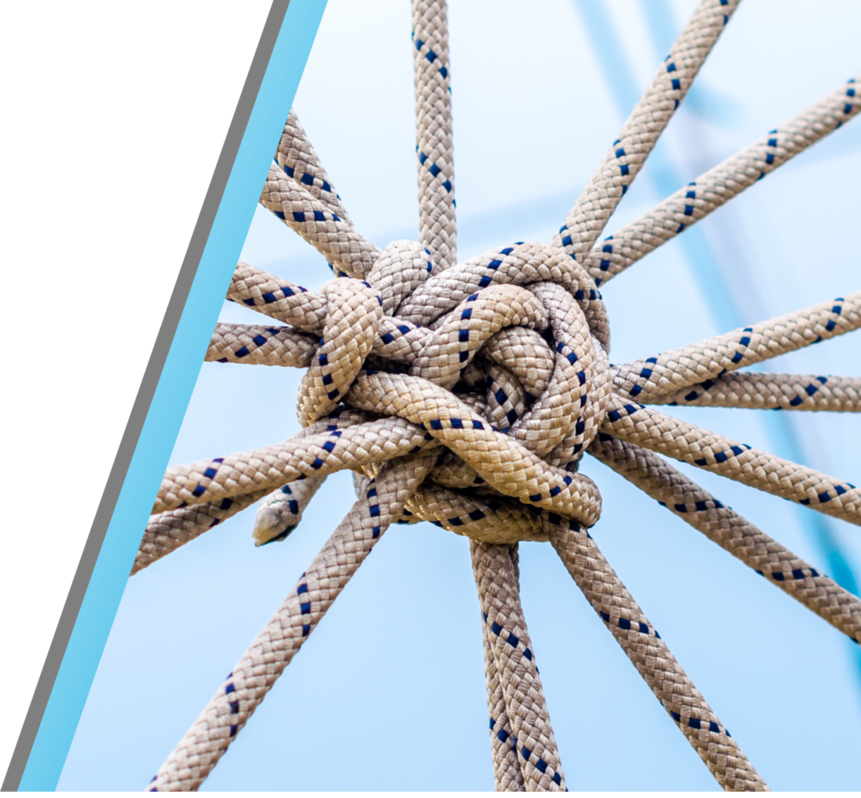
The most at risk students in a school face
complex problems.
They are LIKE A KNOT --
a bundle of needs that intertwine into a ball of frustration.
Buffum, Mattos & Malone
Taking Action: A Handbook
for RTI at Work

Slide 44
The solution to a knot like this is to carefully unravel and UNTANGLE EACH THREAD that makes up the knot
and address each with
the dedication, focus
and perseverance that
you would want for
your own child.
Buffum, Mattos & Malone
Taking Action: A Handbook
for RTI at Work

Slide 45



LBD Continuums Work
Building a Collaborative Culture through High Performing Teams p.80-81
Communicating
Effectively
p.16-17
Laying the Foundation
p.47-49
Divide into three groups, underline what your is your school and you have evidence to prove it. Highlight what you want your school to be.

Slide 46
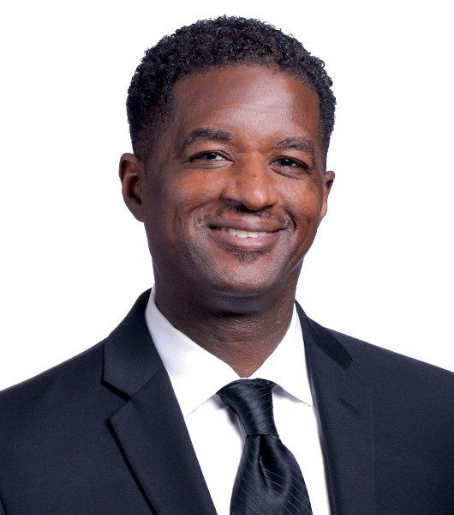
“Children are not mature enough to understand the ramifications of academic failure. We require individuals to be age 16 to drive, 18 to vote, and 21 to drink alcohol, yet we regularly give children “licenses to fail” at a much younger age when they do not exhibit immediate interest in academics.”
Anthony Muhammad
Transforming School Culture: How to Overcome Staff Division, 2018.

Slide 47

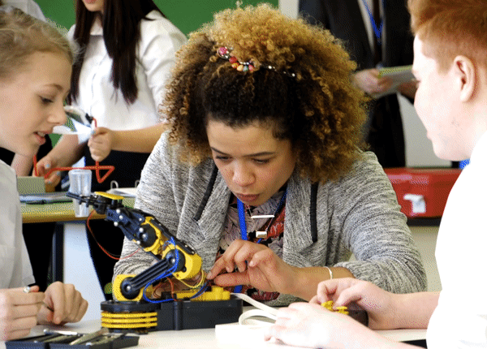
Let’s build our yearlong plan!
What does SAn Cayetano need?
How can Guiding Coalition lead the work?
How can your Solution Tree Associate team support?

Slide 48


Let’s talk about motivation…
Do we, as a staff of San Cayetano, truly believe that all students can learn…at high levels.

Slide 49
“I care more about his/her success than they do.”
“They are lazy.”
“They don’t care at all.”
“They have no work ethic.”
“He/she is manipulative.”
“Our kids can’t do that.”

Slide 50

“When teachers voice these kinds of sentiments publicly in the formal culture of the organization with no worry of challenge by a colleague, it becomes clear that the informal culture of the campus harbors a belief that the student are to blame.”
Roberts, Michael (2023) The Language of Possibility

Slide 51
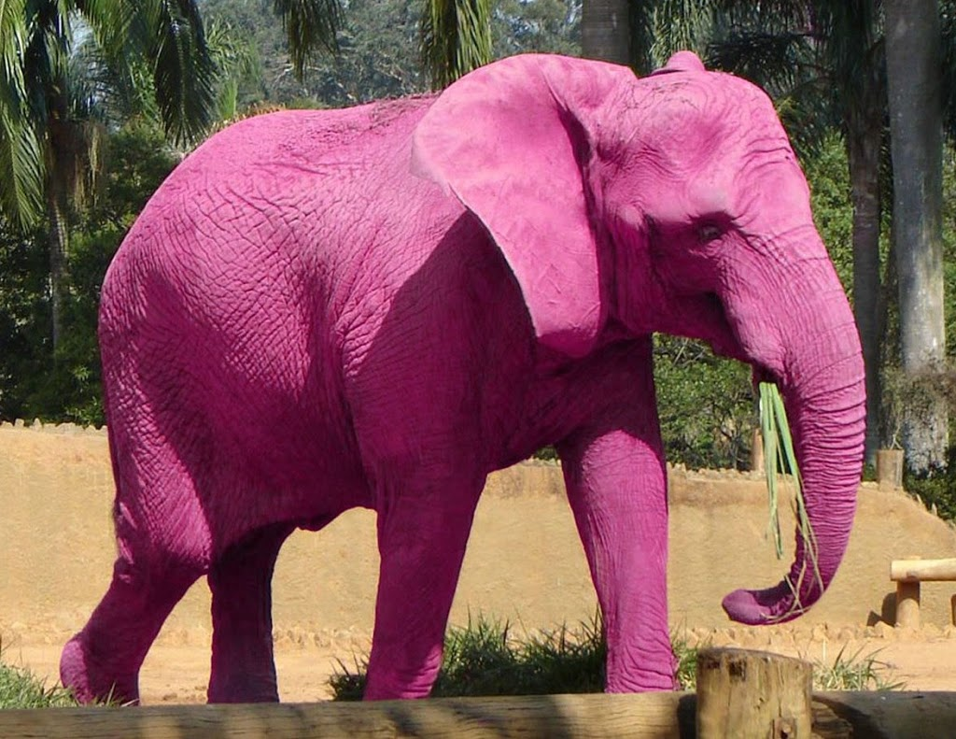
This is dysfunctional.

Slide 52

So, what is the answer?...
There is a guarantee that the curriculum for each course or grade level is standardized across the school.
Viable means that students can reasonably master the essential standards within the time allotted.

Slide 53
Teacher collaborative teams regularly review student formative assessment data to determine whether students have mastered the standards and how to help them get there.

Slide 54
There is a system of interventions and extensions in place to meet the needs of each learner.
  Target the desired outcome
  Design a detailed plan
  Assign lead responsibility
  Monitor student progress

Slide 55
“Building a system more powerful than a student’s willingness to fail needs to be done intentionally and collaboratively. It is not easy, but a system that provides effective interventions will create success for students who may not have had much in their academic careers.”
Roberts, Michael (2023) The Language of Possibility

Slide 56

Discussion with partners:
Do you often hear that the adults feel as though they care more about student success than the students?
How can we as leaders, gently guide the work towards the language of possibility.

Slide 57
Break

Slide 58

Thank You!
To schedule professional development at your site, contact Solution Tree at 800.733.6786.
Aisha Lynn Thomas • aisha.thomas@gmail.com
‹#›

