Slide 1
The Foundations of
Taking Action
Aisha Thomas
October 2023

Slide 2
It is imperative to understand the
three big ideas:
1. Focusing on learning
2. Creating a collaborative culture
3. Focusing on results

Slide 3
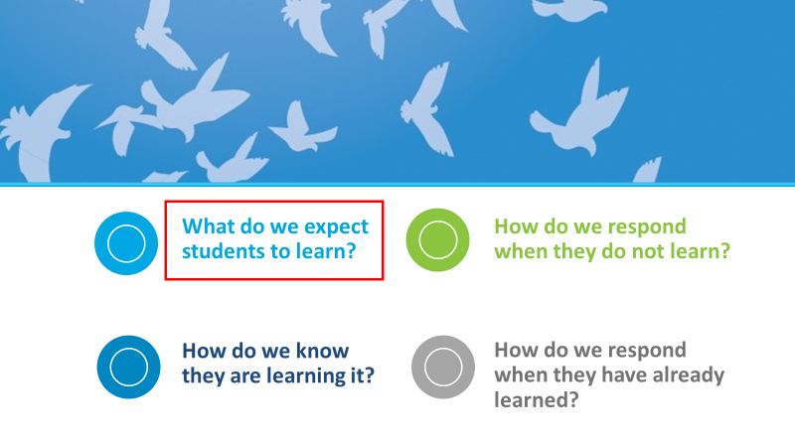

Slide 4
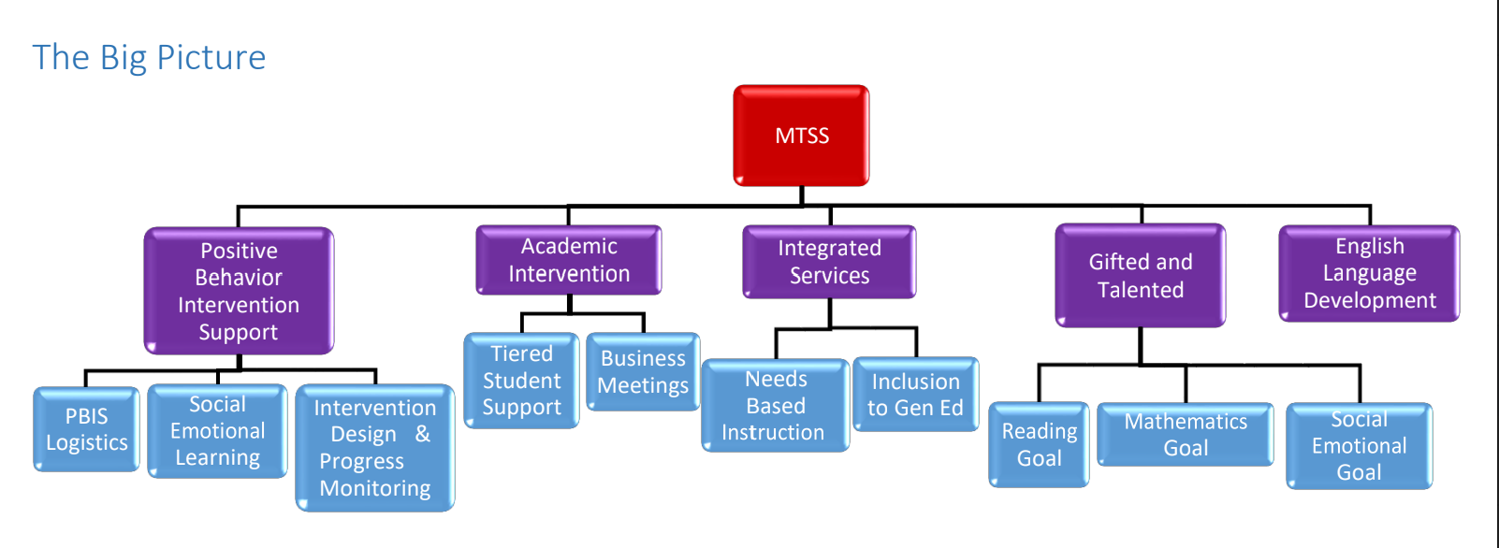

Slide 5
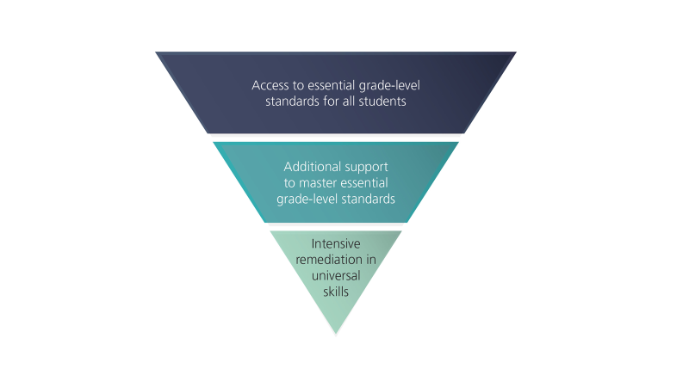

Slide 6
